Slide 1

Dectection Of Anomalous Behaviour In An Examination Hall Towards Automated Proctoring
by
B Supraja
Roll No. 204G1A05A5
B Yuva Kishore
Roll No. 204G1A05C6
C Raveendra
Roll No. 204G1A0580
M Tharun Kumar
Roll No. 204G1A0581
Under the guidance of
Mrs. N. UshaSree M.Tech
Assistant Professor
Assistant Professor
Department of Computer Science and Engineering
Srinivasa Ramanujan Institute of Technology
Autonomous
Rotarypuram Village, B K Samudram Mandal, Ananthapuramu – 515701.
2023-2024

Slide 2
Comments
Future extension.
Whether Camera can Identify single or multiple faces?
Datasets train check.
Environmental level.
To study base paper’s.
Clarity for edge detection.

Slide 3

Contents
Abstract
Introduction
Literature Survey
Existing System
Proposed System
Planning
Design
Implementation
Research Paper
References

Slide 4
Abstract
The anomalous behaviour is hard to be detected simultaneously in a complex scene such as detecting abnormal movements of examinee in examination rooms. Modelling activities of moving objects and classifying them abnormal or anomalous is a major research problem in video analysis. In this paper, we make use of the of neural networks and Gaussian distribution to help solve this problem by building a prototype of a monitoring system that consists of three stages: face detection using haar-cascade detector, suspicious state detection using a neural network and lastly anomaly detection based on the Gaussian distribution.
The main idea is to decide on-whether the student is in a suspicious state or not using a trained neural network and then decide that a student performs an anomalous behaviour based on how many times he was found in a suspicious state in a defined time duration.
Keywords: Abnormal behaviour,

Slide 5
Introduction
The transition to online examinations has introduced challenges in ensuring the integrity of academic assessments. Automated proctoring systems offer a technological solution to monitor and detect anomalous behavior during exams. By leveraging advanced algorithms and machine learning techniques, these systems aim to uphold academic integrity and fairness in virtual learning environments. Detecting anomalies such as unauthorized collaboration or cheating is crucial for maintaining assessment standards and preserving the credibility of online education.
Humans are considered the most active objects; thus, detecting worker behaviour is vital. Anomaly detection, which is a key task of modern automated monitoring systems, highly impacts diverse fields such as health care, sports analysis, industries, and security.

Slide 6
Literature survey
[1] proposed a system that is capable of continuously monitoring the behaviour of students using a fixed camera. The system consists of three layers: Face Detection, Suspicious state Detection and anomalous Detection. The behaviour is measured using a sequence of n-frames based on the Gaussian distribution method. The anomalous behaviour is decided based on how many times the student was found in suspicious state in define time duration.
Richard Miller[2] , Amanda Adams proposed an iterative approach to refining automated proctoring algorithms. It proposes learning from past false positives to adapt algorithms and improve their ability to differentiate between legitimate and suspicious behaviours.
[3],This research explores the integration of natural language processing (NLP) and computer vision techniques to detect cheating. It presents algorithms that analyze text inputs, identify plagiarized content, and combine it with image analysis to detect the presence of unauthorized materials.

Slide 7
Literature survey
[4],This paper presents a comprehensive approach to exam hall surveillance using face detection and machine learning algorithms. It highlights the integration of face detection with other monitoring techniques to enhance anomaly detection.These studies collectively highlight the significance of using face detection to monitor abnormal behaviour in exam halls. They discuss various aspects such as accuracy, privacy concerns, integration with other technologies, and the potential benefits of implementing face detection-based proctoring systems.
[5], Review studies that utilize computer vision techniques such as object detection, facial recognition, and gaze tracking to monitor examinees during exams. Highlight approaches for detecting behaviors like looking away from the screen, using unauthorized materials, or interacting with others during exams.

Slide 8
Existing System
Existing systems that utilize fuzzy clustering, the Otsu method, or the KNN classifier algorithm for detecting anomalous behavior may encounter several difficulties. Here are some challenges associated with each algorithm:
^{Disadvantages}
Fuzzy clustering algorithms may struggle to capture complex and diverse behavior patterns exhibited by examinees during examinations.
The Otsu method's performance may degrade in the presence of noise or variability in the examination hall environment, such as varying lighting conditions, camera angles, or student behaviors. This could lead to false positives or negatives in anomaly detection.
By using these algorithms face challenges in understanding complex behavior ,setting clear rules for what’s acceptable and what’s not, dealing with changes in the environment, handling lots of different factors, and making the right decisions based on the data they receive.

Slide 9
Proposed System
The proposed system utilizes the Haar-features algorithm, often referred to as Haar cascades, is a machine learning-based object detection method that is commonly used for tasks like face detection
The proposed system utilizes the neural network algorithm to Ensuring privacy and ethical use of surveillance technology and Handling false positives and negatives to avoid unnecessary disruptions.
The aim of pre-processing is an improvement of the image data that suppresses unwanted distortions or enhances some image features important for RGB and Grey scale images.
Advantages
Overall, these algorithms offer advantages such as computational efficiency, robustness, accuracy, adaptability, and real-time monitoring capabilities, making them well-suited for detecting anomalous behavior in examination

Slide 10
Proposed System
The proposed system aims to achieve the following objectives
Implement a system capable of detecting anomalous behavior in real-time during online examinations.
Develop algorithms that accurately classify examinee behaviors as either normal or anomalous.
Prioritize the analysis of facial expressions and gestures associated with cheating behaviors.
Develop a system that can adapt to diverse examination environments and scale to accommodate varying numbers of examinees.
By achieving these objectives, the proposed system aims to enhance the integrity and fairness of online examinations by effectively detecting and deterring anomalous behavior in examination

Slide 11
Planning
Objective
To monitor the abnormal behaviour of the persons in exam hall by using face detection process .
To implement strategies that minimize false positive alerts, improving the accuracy of the automated proctoring system and reducing unnecessary disruptions.
Performance
Overall, the resulting performance of the proposed system would be evaluated based on its ability to detect anomalous behavior accurately, efficiently, and in compliance with privacy regulations. Continuous monitoring, evaluation, and refinement of the system are essential to ensure optimal performance and reliability in real-world examination scenarios. Additionally, benchmarking against established standards and comparing performance with existing solutions can provide insights into the system's effectiveness and areas for improvement.

Slide 12
Planning
Functional Requirements
1.video streaming
2.Preprocessing
3.visualization
3.face recognition
4.comparioson with database models
5.detection of output behaviour of person with face

Slide 13
Planning
Non-Functional Requirements
Usability requirement
Serviceability requirement
Manageability requirement
Recoverability requirement
Security requirement
Data Integrity requirement
Capacity requirement
Availability requirement

Slide 14
Planning
Software Requ irements:
Hardware Requirements:
Processor - I3/Intel Processor
Hard Disk -160GB
RAM - 8Gb
Software Requirements:
Operating System : Windows 7/8/10
IDE : Pycharm.
Libraries Used : Numpy, Pandas, OS,Flask.
Technology : Python 3.6+

Slide 15
Planning
Methodology
This project uses Agile methodology. In that we use scrum agile methodology.
Scrum is characterized by cycles or stages of development, known as sprints.
It has four stages: Planning, Implementation, Testing and review.
Advantages:
This Methodology has ability to change and adapt with and satisfy the changing needs in short term.
Requires less documentation.

Slide 16
Planning
Work Schedule
S.No | Development Stage | Duration
1. | Domain and Title | 1 week
2. | Literature Survey | 2 weeks
3. | Planning | 1 week
4. | Design | 1 week
5. | Requirements Gathering | 1 week
6. | Testing | 3 weeks
7. | Implementation | 4 weeks

Slide 17
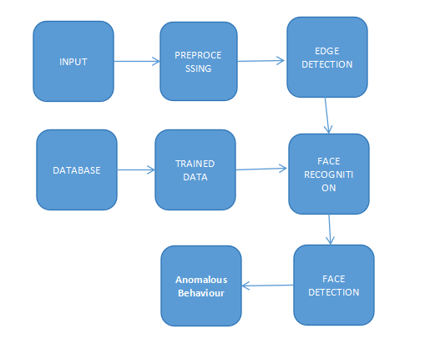
Design - Block Diagram
Block diagram

Slide 18
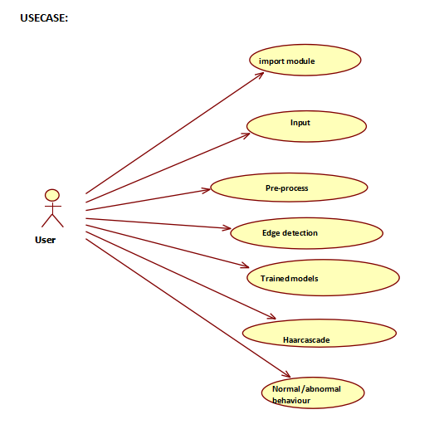
Design - Use Case Diagram

Slide 19
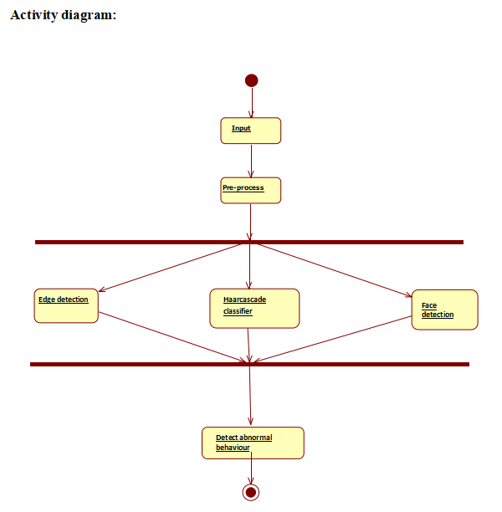
Design - Activity Diagram for Admin

Slide 20
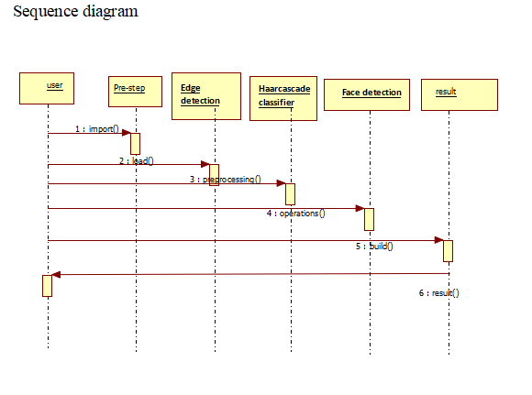
Design - Sequence Diagram

Slide 21
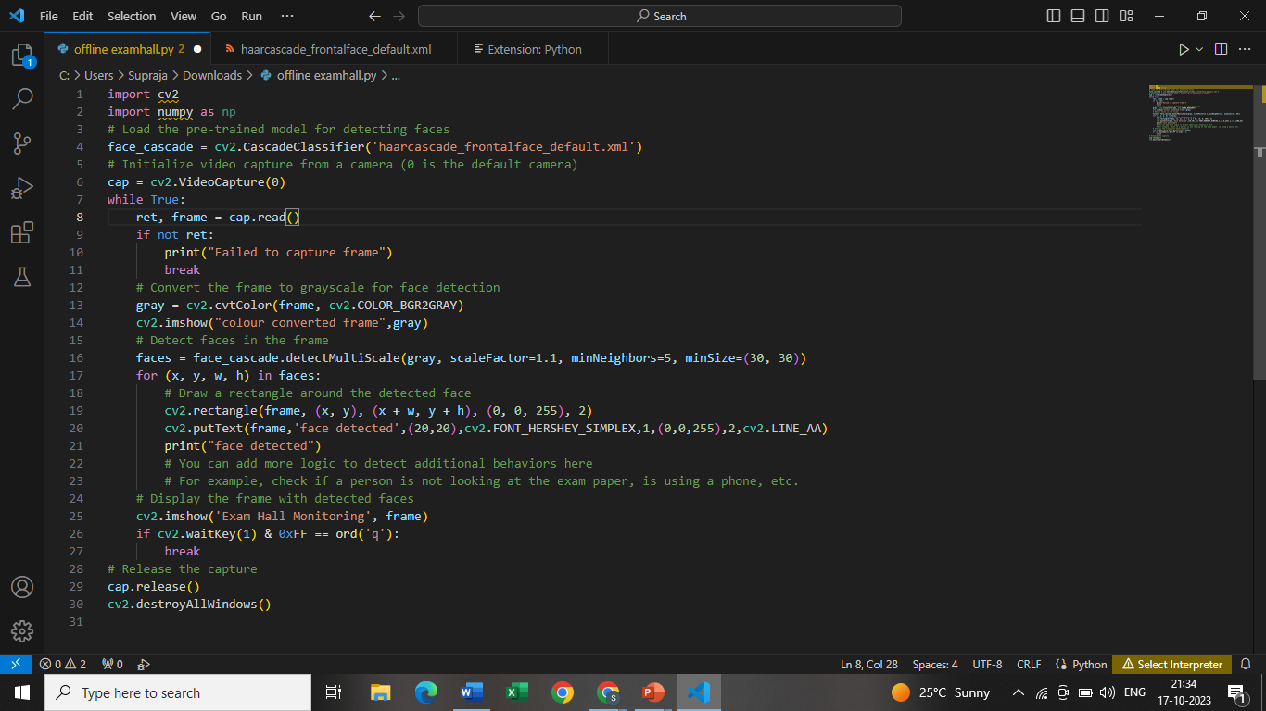
Implementation
LOGIN PAGE CODE

Slide 22
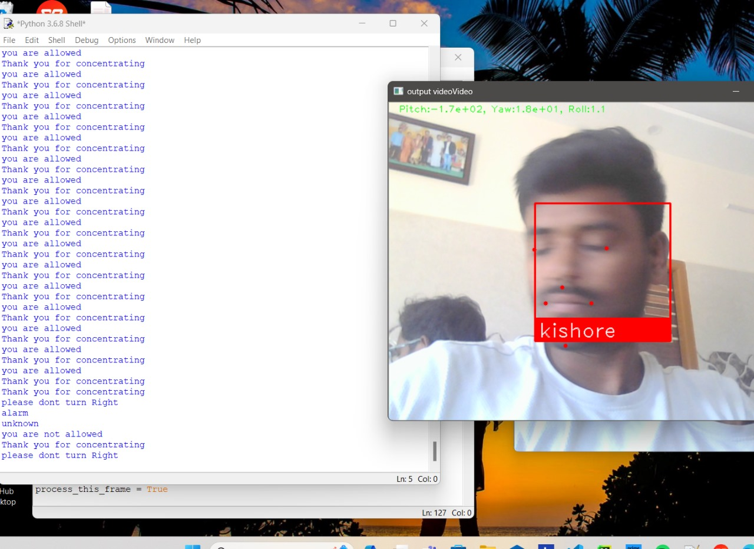
Design and implementation of second objective
Figure 4: sequence diagram

Slide 23
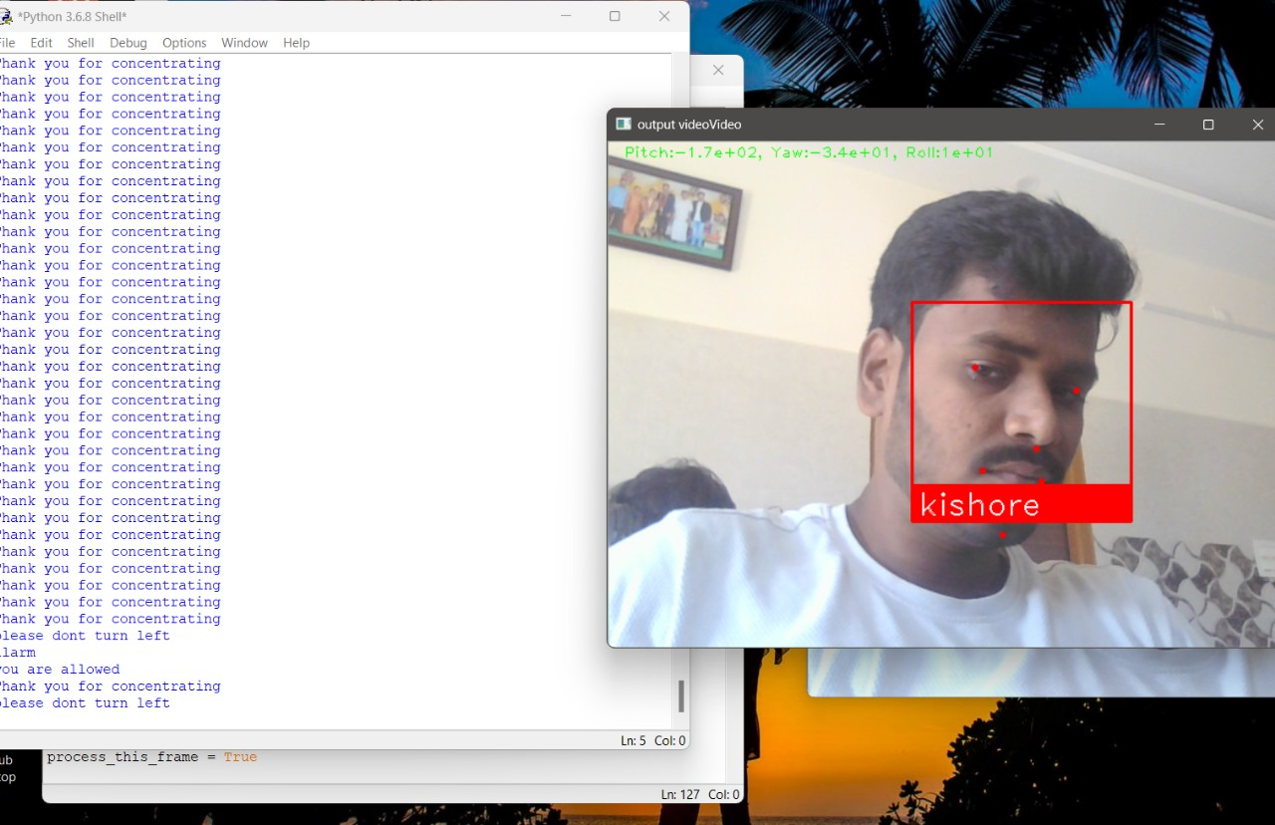
Implementation

Slide 24
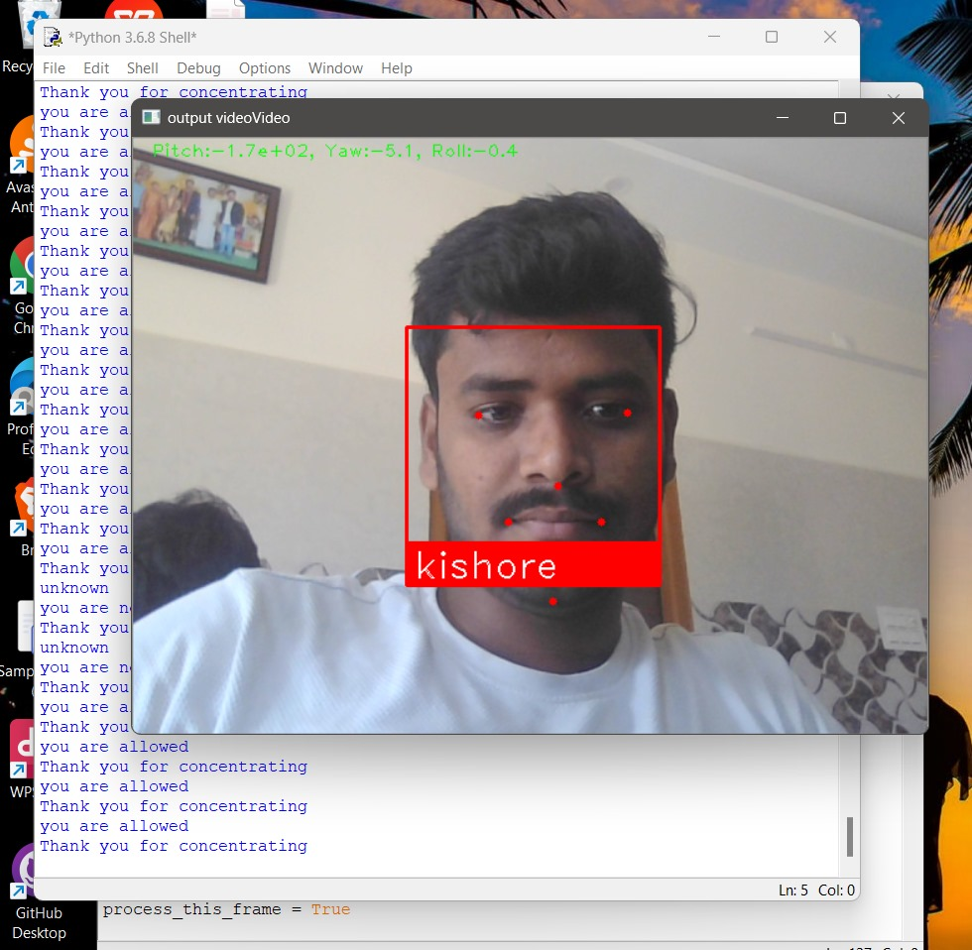
Implementation

Slide 25
Research Paper
Research Paper

Slide 26
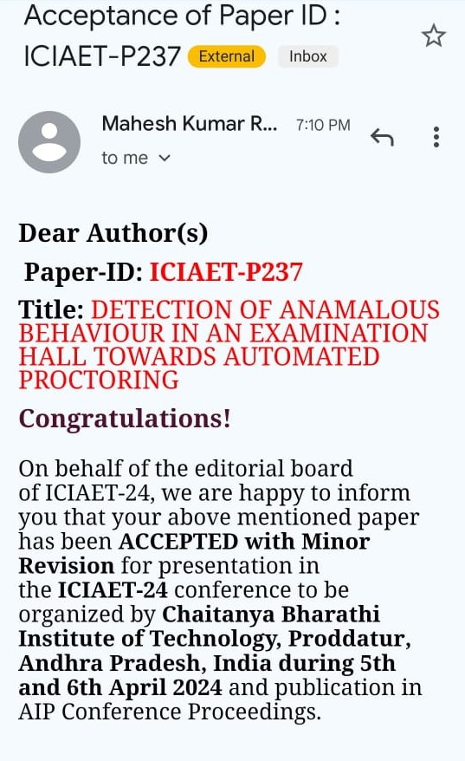
Acknowledgement

Slide 27
References
[1] Ben-Musa, Ahmad Salihu, Sanjay Kumar Singh, and Prateek Agrawal. “Suspicious Human Activity Recognition for Video Surveillance
System." (2014).
[2] Yong, Lu, and He Dongjian. "Video-based detection of abnormal behaviour in the examination room." Information Technology and Applications (IFITA), 2010 International Forum on. Vol. 3. IEEE, 2010.
[3] H. Rowley,S. Baluja, andT.Kanade, “ Neural network grounded face discovery ”. IEEE Deals on Pattern Analysis and Machine Intelligence,vol. 20, no. 1,pp. 23- 38,1998.
[3] Journal of Scientific & Engineering Research, Volume 3, Issue 4, October- 2018 ISSN2229- 5518 IJSER © 2017 http//www.ijser.org [10] T. Darrell,B. Moghaddam andA.P. Pentland, “Active face trackingand pose estimation in an interactive room ”, IEEE Computer Society Conference on Computer Vision.
[4] https;/www.javatpoint.com/haar-cascade-algorithm

Slide 28
Thank You!!!

